Slide 1
Transaction-Flow Testing
Presented By
Dr. Shazzad Hosain
Asst. Prof., EECS, NSU

Slide 2
Transaction-Flow Testing
Transaction flows are introduced as a representation of a system’s processing.
Transaction Flow testing are to the independent system tester what control flow were to the programmer
Control Flow graph- Structural model
Transactional Flow graph - Model of the structure of the system’s behavior

Slide 3
Transaction
A transaction is a unit of work seen from a system user's point of view.
It’s a sequence of operations, some of which are performed by a system, persons or devices that are outside of the system.
It begins with Birth-that is they are created as a result of some external act.
At the end of the transaction's processing, the transaction is no longer in the system.

Slide 4
A Simple Transaction
Example: the sequence of steps in a transaction in an online information retrieval system
1. accept inputs 7. Accept Inputs
2. Validate inputs (Birth of tr.) 8. Validate inputs
3. Transmit ack. to the user 9. Process the request
4. Process input 10. Update file
5. Search file 11. Transmit output
6. Request direction from user 12. Record transaction in log & cleanup (Closure)
Users View of a transaction : Single step
Systems view : Sequence of many operations
ref boris beizer

Slide 5
Transaction-Flow Graphs
Transaction flows are representation of a system's processing.
Methods applied to control flow graphs are used for functional testing.
The transaction flow graph is to create a behavioral model of the program that leads to functional testing.
It is a model of the structure of the system's behavior (functionality).

Slide 6
Example of a Transaction flow (diagram)
_{U2}
User (terminal) Terminal controller CPU
cancel
Request
Type
User
Begin
order
Request
order
from CPU
Accept
Order from
CPU
Process
Form
B
help
Y
More
Fields?
B
Transmit
Page to
terminal
C
Accept
Input
Field
Transmit
To CPU
D
More
Pages ?
User wants
Review?
CPU-
Accept
Confirm
Valid ?
Y
N
N
Done
D
Set up
Review
Transmit
Diagnostic
to Terminal
C
ref boris beizer

Slide 7
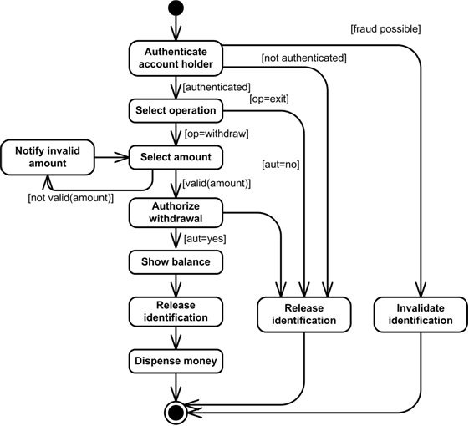

Slide 8
Usage
A big system such as an air traffic control or airline reservation system, has not hundreds, but thousands of different transaction flows.
Transaction flowgraphs are relatively simple, many of which have a single straight-through path.
Loops are infrequent compared to control flowgraphs.
The most common loop is used to request a retry after user input errors.
  For example, ATM system allows the user to try, say three times, and will take the card away the fourth time.

Slide 9
Complications
In simple cases, transactions have a unique identity from birth to completion.
However, the transactions can give birth to others, and transactions can also merge.
Births - Three different types: Decision, Biosis and Mitosis
Mergers: Three types of junctions: Ordinary Junction, Absorption, Conjugation

Slide 10
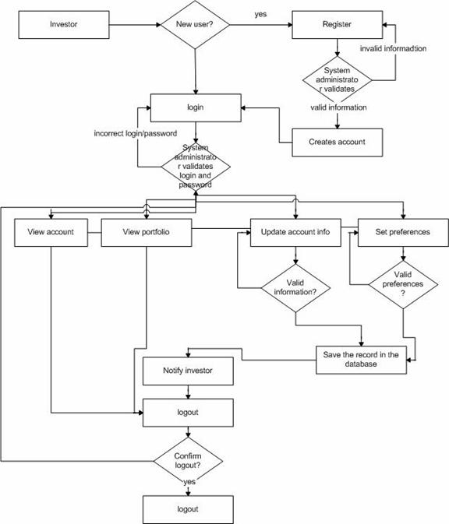

Slide 11
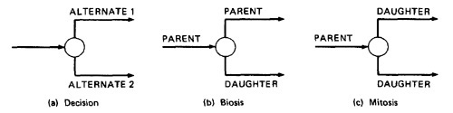
Births
Decision: The transaction takes one or the other alternative but not both.
Biosis: Gives birth to a new transaction, both transaction continue, and parent retains it identity.
Mitosis: Parent is destroyed and two new transactions are created.

Slide 12
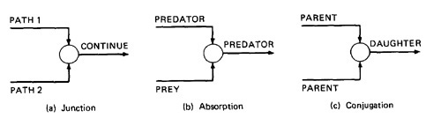
Mergers
Ordinary Junction: A transaction can arrive either on one link or the other.
Absorption: The predator absorbs prey. The prey gone but the predator retains its identity.
Conjugation: The two parent transactions merge to form a new daughter.

Slide 14
Complications
We have no problem with ordinary decisions and junctions.
Births, absorptions, and conjugations are as problematic for both software designer and test designer
As a consequence, such points have more than their share of bugs.
The common problems are: lost daughters, wrongful deaths, and illegitimate births.

Slide 15
Transaction –Flow Testing Techniques
Get the transaction flows
  Complicated systems should have explicit representations of the transactions flows
  Transaction flows are like control flow graphs, thus they should be in increasing levels of detail.
  Detailed transaction flows are a mandatory pre-requisite to the rational design of a system's functional test.

Slide 16
Transaction –Flow Testing Techniques
Inspections, Reviews, Walkthroughs
  Transaction flows are natural agenda for system reviews or inspections.
  In conducting the walkthroughs, you should:
    Discuss enough transaction types to account for 98%-99% of the transaction the system is expected to process.
    Discuss paths through flows in functional rather than technical terms.
    Ask the designers to relate every flow to the specification and to show how that transaction, directly or indirectly, follows from the requirements.

Slide 17
Transaction –Flow Testing Techniques
Inspections, Reviews, Walkthroughs, cont.
  Make transaction flow testing the corner stone of functional testing, as path testing for unit testing.
  Select additional flow paths for loops, extreme values, and domain boundaries.
  Design more test cases to validate all births and deaths.
  Publish and distribute the selected test paths through the transaction flows as early as possible so that they will exert the maximum beneficial effect on the project.

Slide 18
Transaction –Flow Testing Techniques
Path Selection
  Select a set of covering paths (C1 + C2) using the analogous criteria used for structural path testing.
  Select a covering set of paths based on functionally sensible transactions.
  Try to find the most tortuous, longest, strangest path from the entry to exit of the transaction flow.

Slide 19
Path Sensitization
Most of the normal paths are very easy to sensitize
  80% - 95% transaction flow coverage (c1+c2) is usually easy to achieve.
The remaining small percentage is often very difficult.
If there are sensitization problems on the easy paths, then bet on either a bug in transaction flows or a design bug.

Slide 20
Review: Path Sensitization
Any path of that set, interpret the predicates
Trace the path, multiply the individual compound predicates
  Find boolean expressions like
  The terms in parenthesis are compound predicate
  Each letter (A, B, …) stands for simple predicate
Multiply out the expression to find sum-of-products forms
Each product term denotes a set of inequalities
If any one is solved, you found a set of input values for the path
  In that case it is achievable, otherwise not
The act of finding a set of solutions from path predicate expression is called path sensitization.
Notes:
Converted to sum-of-products by de-morgan law. By negation of one from other. Thus inequalities needs to be tested

Slide 21
Path Instrumentation
Instrumentation plays a bigger role in transaction flow testing than in unit testing.
The information of the path taken for a given transaction must be kept with that transaction and can be recorded by a central transaction dispatcher or by the individual processing modules.
In some systems, such traces are provided by the operating systems or a running log.

Slide 22
References
Chapter 4, Software Testing Techniques - Boris Beizer

Slide 23
Transaction Example
An online information retrieval system
  Accept input (tentative birth)
  Validate input (birth)
  Transmit acknowledgement to requester
  Do input processing
  Search file
  Request directions from user
  Accept input
  Validate input
  Process request
  Update file
  Transmit output
  Record transaction in log and clean up (death)

